Slide 1
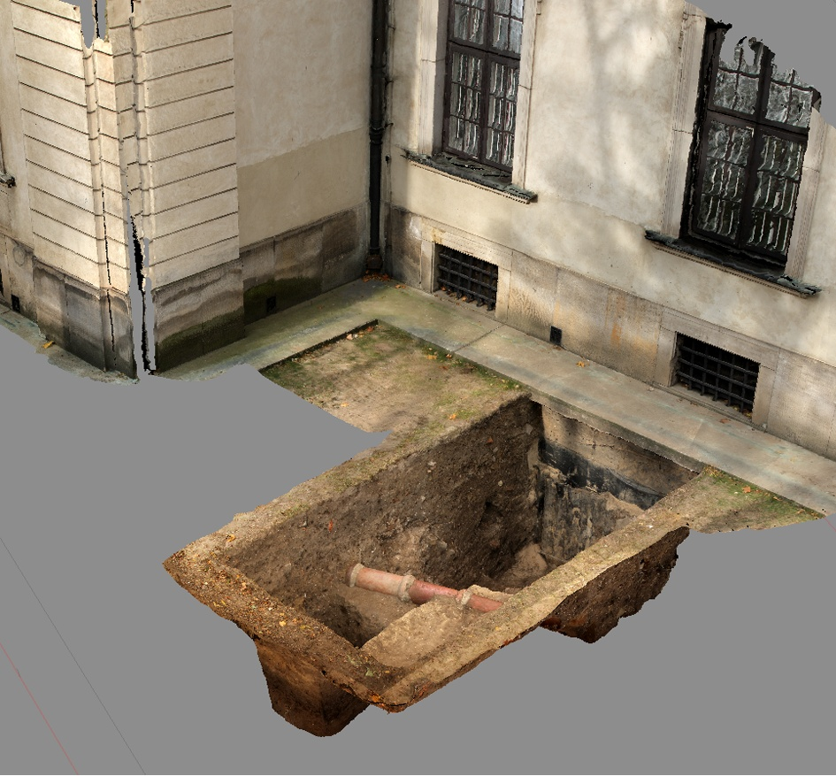
Report on rescue archaeological research
carried out at the Krasiński Palace in Warsaw

Slide 2
Archaeological research at the building of the Krasiński Palace (Palace of the Commonwealth) had been commissioned by the National Library and were carried out under the Archaeological Research programme being a part of the “Conservation and revitalization of the Krasiński Palace (Palace of the Commonwealth) in Warsaw – European 17th century cultural heritage” co-financed with the funds of the 2009-2014 EEA Financial Mechanism.
.

Slide 3
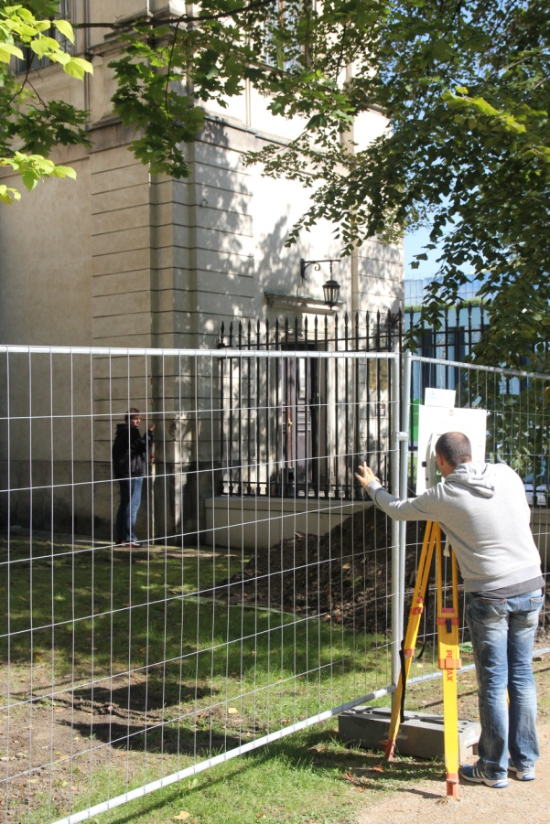
Before the start of the excavations geodetic survey had been carried out.

Slide 4
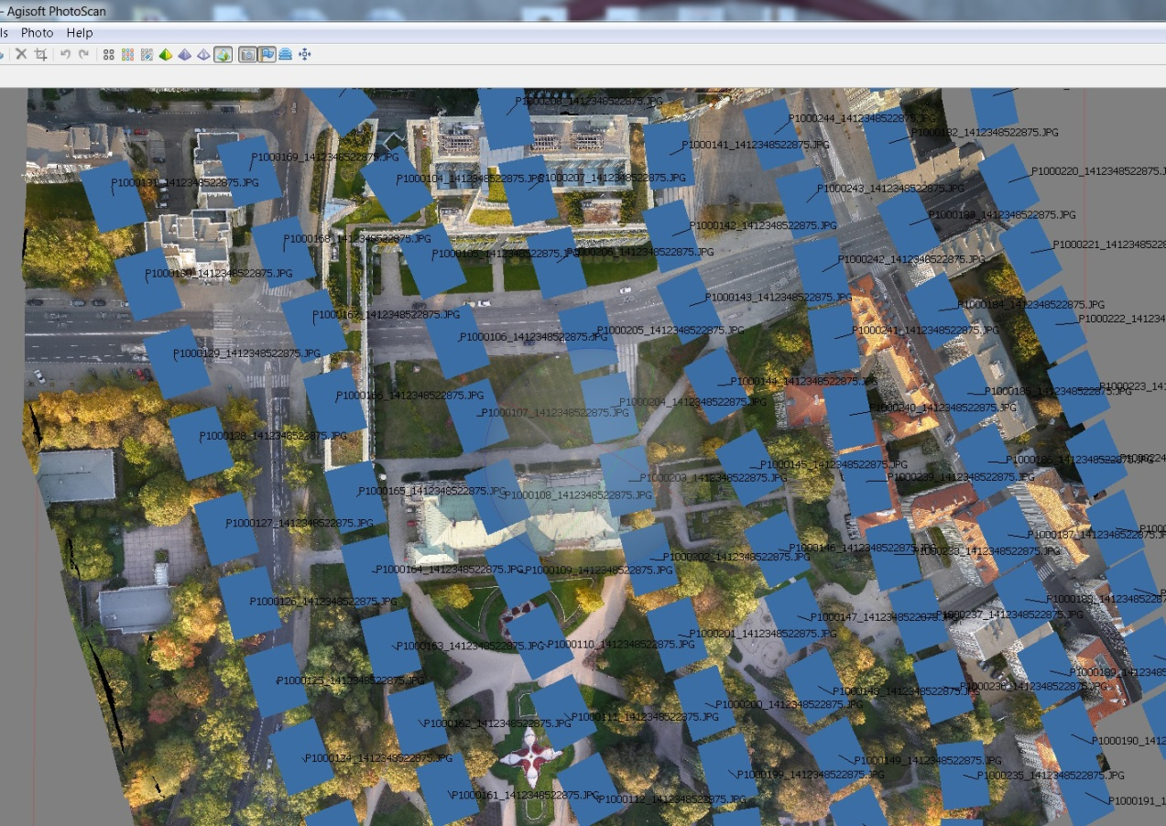
The large area mapping was performed with the use of the Sirius Topcon system, the result of which was a three-dimensional numerical model of the Krasiński Square area (performed by TPI).

Slide 5
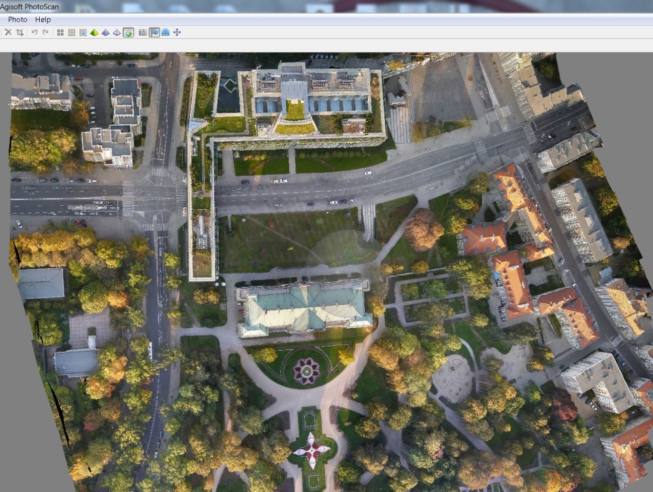
A three-dimensional Sirius numerical model is a geodetic record obtained using aerial three-dimensional photogrammetry and positioned with the use of a GPS base station with an accuracy to of one centimetre.
.

Slide 6
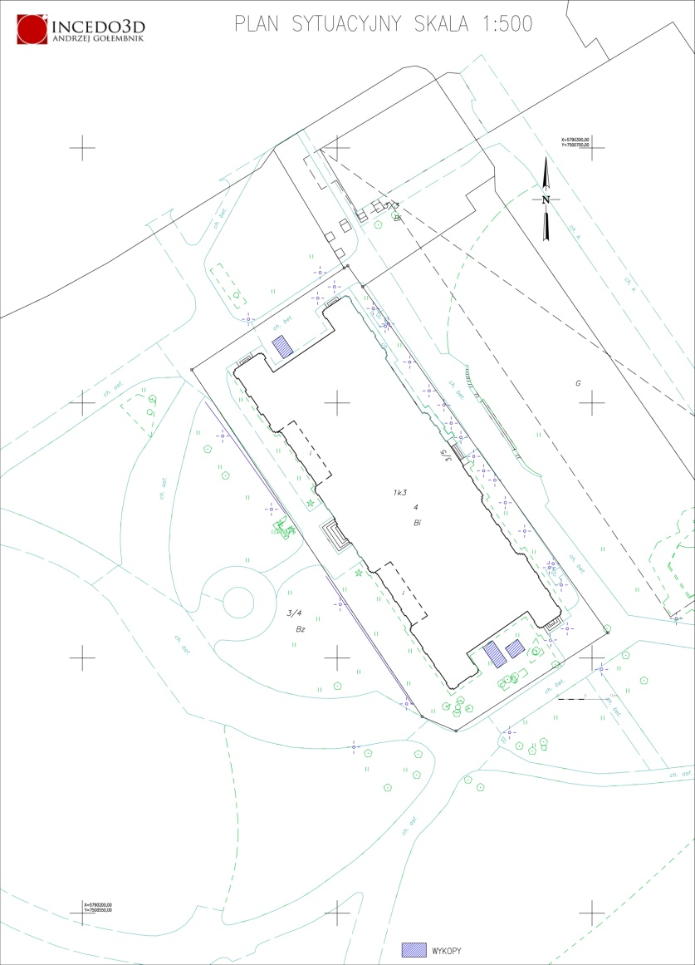
The research covered the aggregate area of 36 sq. m, with the digs situated at the gable walls of the Palace.

Slide 7
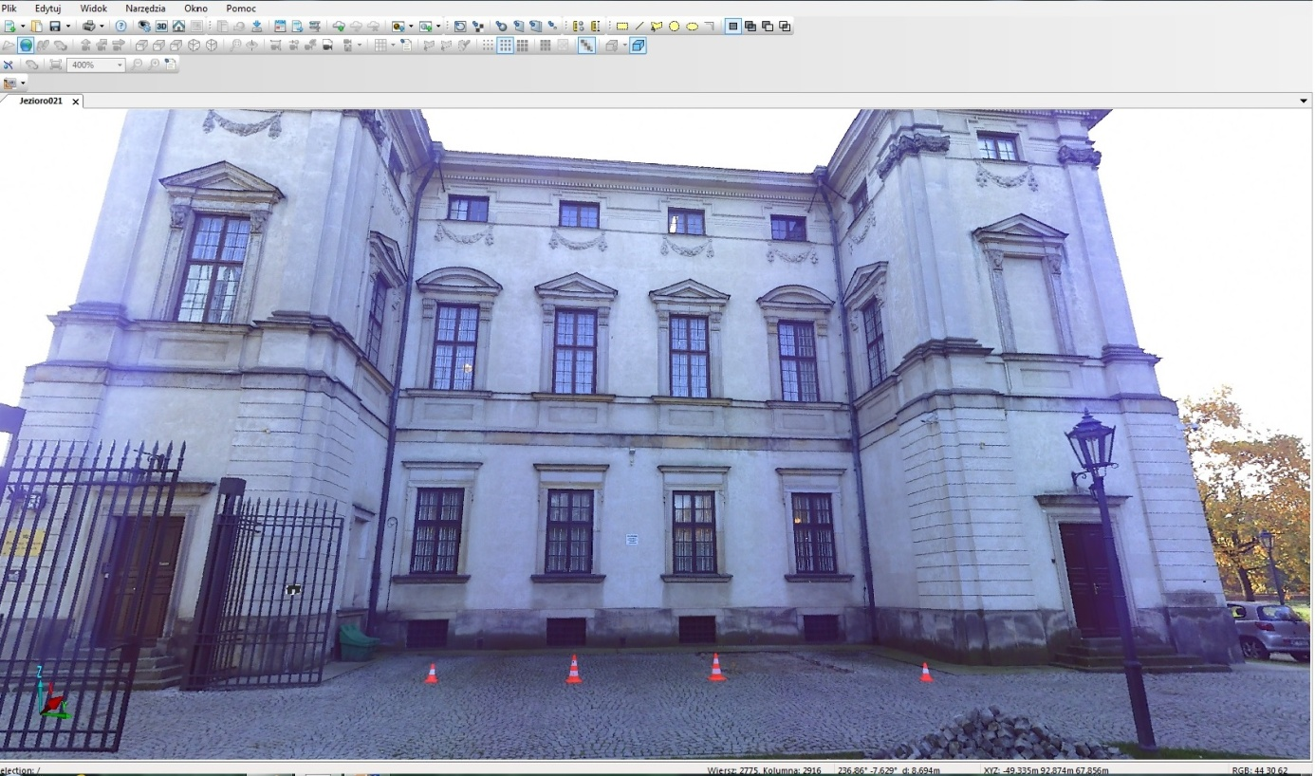
The preparations included 3D laser scans of the gable walls. The scans were geodetically linked yielding the full x,y,z position. Also the outline of archaeological excavations was scanned, which was to provide reference for further surveying.

Slide 8
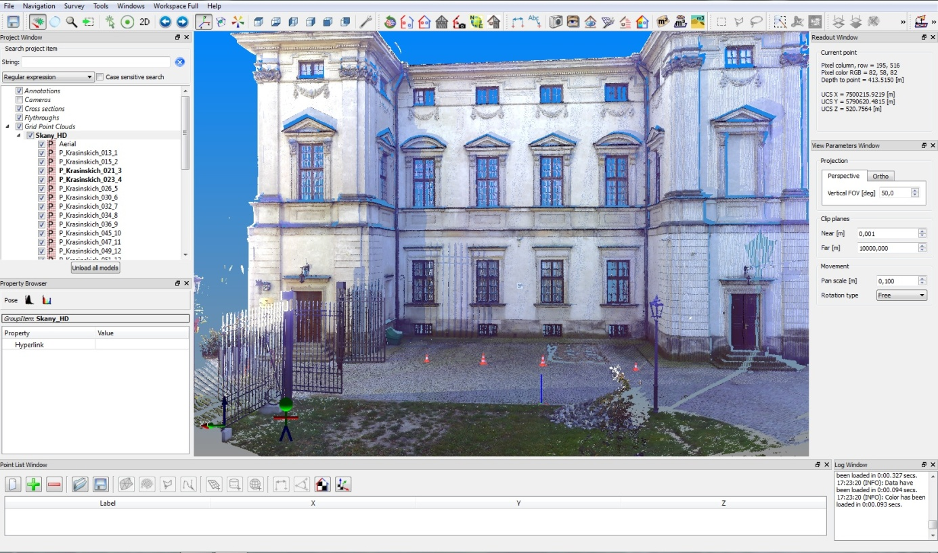
In that way basis geo-reference data from the building lent the attributes of coordinates to the researched objects found in the digs and recorded with the use of 3D ground photogrammetry. Having been transformed into a cloud of pints, the coordinates were then combined with the scans. That unique documenting technique was used for the first time in Poland.

Slide 10
The photographs used for creating a three dimensional model were taken with the Canon 60D camera with a calibrated Sigma DC lens. The basic photogrammetric software was PhotoScan.

Slide 11
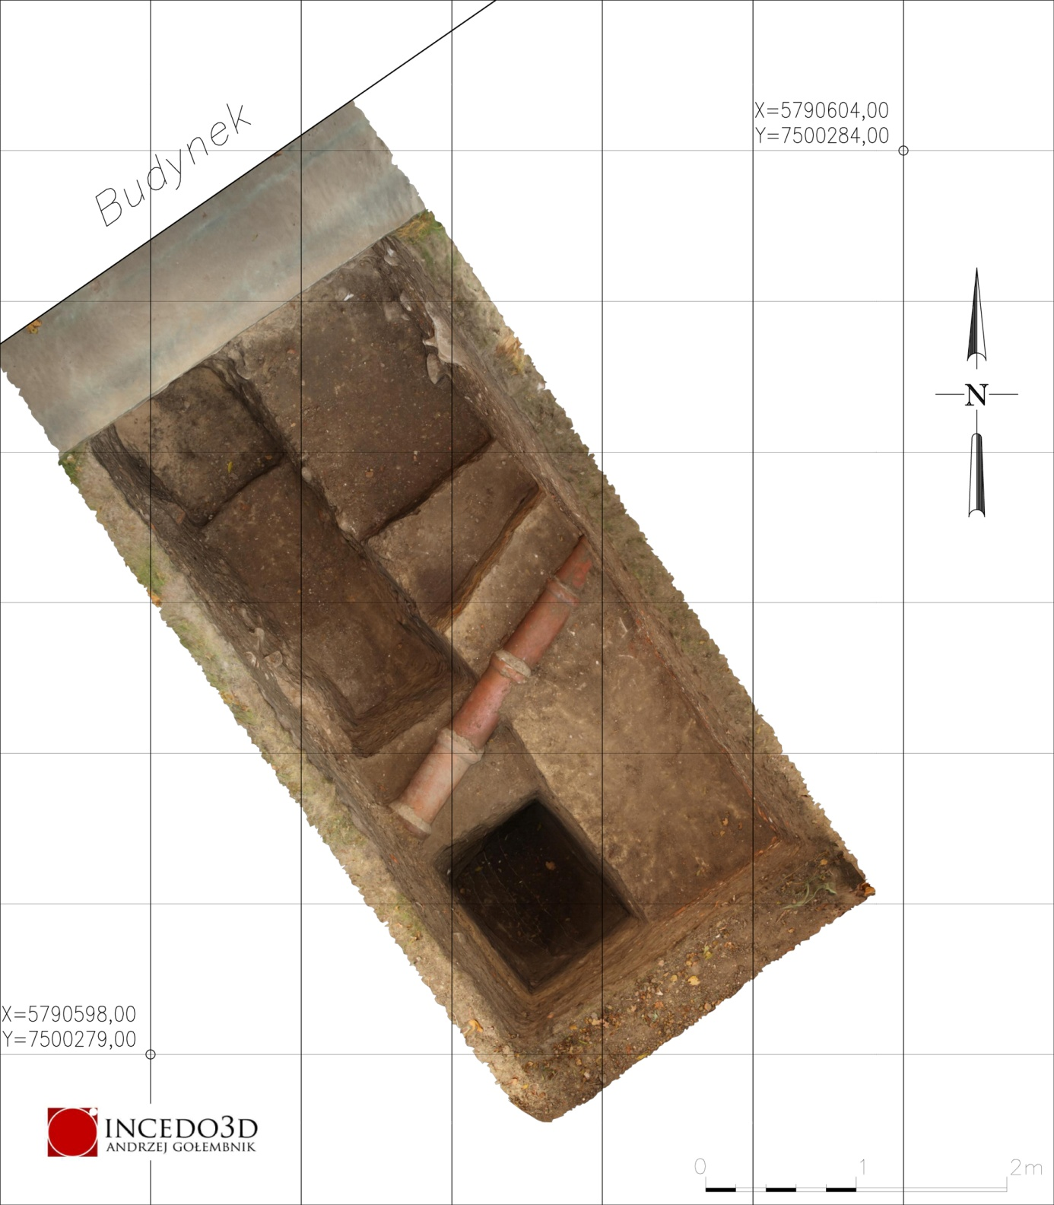
Exploration was carried out manually, according to the highest research standards, with the use of the stratigraphic method and a metal detector.

Slide 12
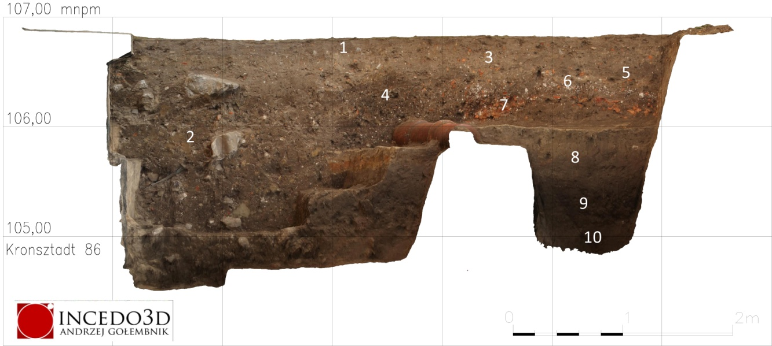
Fragment profilu wschodniego wykopu 1
Ten layers were marked off in the first excavation, with the majority of them being contemporary, connected with cleaning of the area after the repair and installation works twenty years ago. The historical layers start with the 5th one. The next layer (6) is a witness to a local refurbishment which took place – as evidenced by skimpy historical material – in the mid-18th century. Below there is a construction layer (7), related to the construction of the Palace. Its ceiling is located in this area at ca. 106 m a.s.l. That layer is situated directly on a massive bed of clay (8), which constitutes an element of levelling which raises the area around the construction site by over 0.5 metres. It is certain that clay was spread during earthworks for foundations and ceilings. The layer of clay is deposited on a stratum of dark brown sandy compact humus (9). That layer, its structure and contents provide an irrefutable evidence of passive settlement. That layer was accumulated naturally during the broadly conceived Middle Ages and is connected with the establishment of first jurydykas of Warsaw.

Slide 13
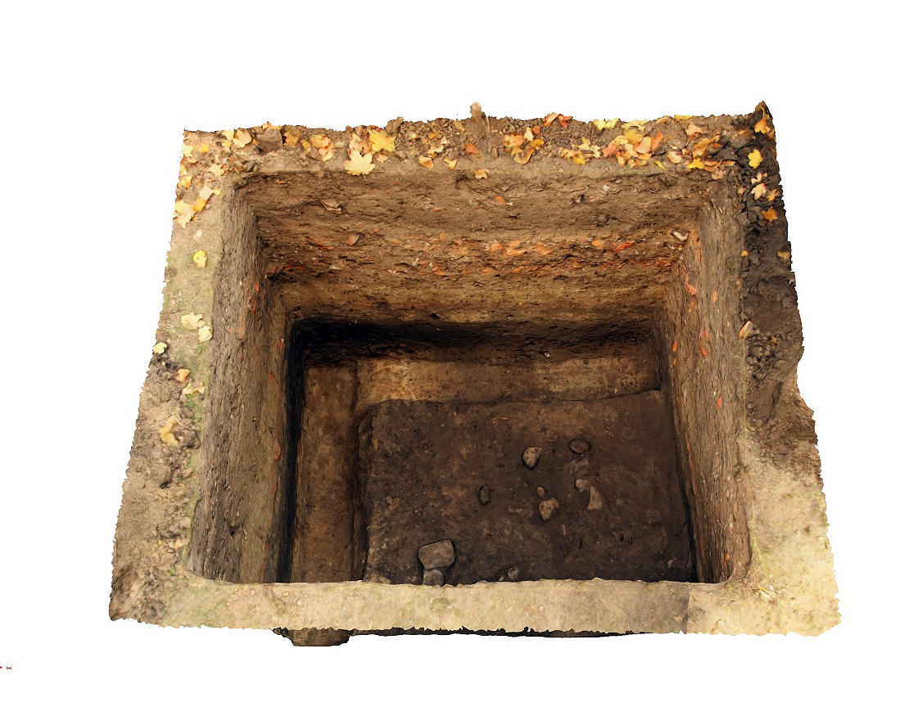
Similar stratigraphy was recorded in excavation no. 2. However, in there it had not been contaminated with contemporary digs. Noticeable is the presence of burnt stones in the floor of the Medieval layer. Above that layer, which had been accumulating for a long time, there is a deposit of clay from digging of the palace foundations. A layer of debris dating back to the time of construction of the Palace was recorded above.

Slide 14
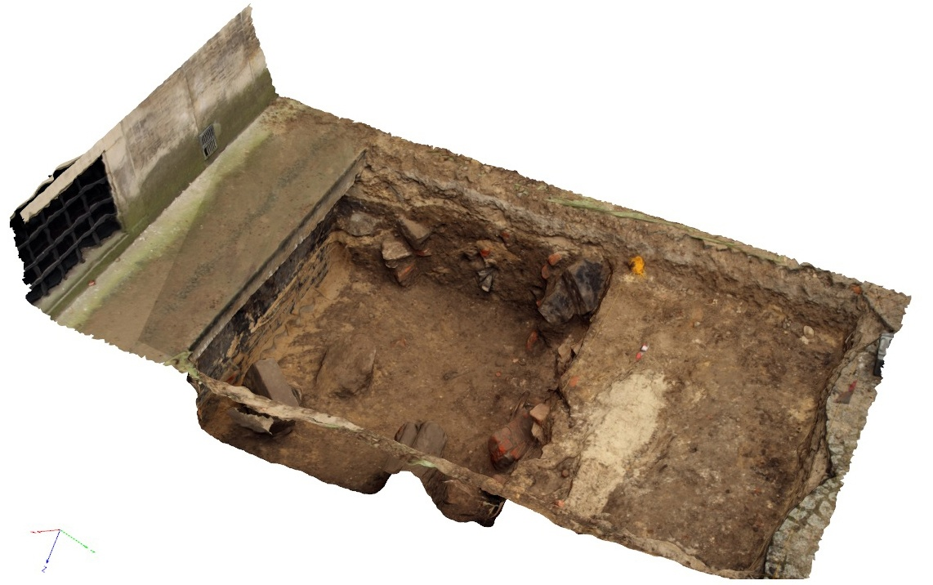
Excavation no. 3 was situated on the north side of the Palace. The majority of its area was taken by contemporary layers. Those situated closer to the wall constitute a filling of the construction dig. The rest, occupying the majority of the area, are the result of filling a bomb crater with debris; as told by an inhabitant of Warsaw (Mr. Waldemar Rzepiński) the bomb fell during the Warsaw Uprising on the west side of the Palace. Due to the presence of high voltage cables exploration in the central part of the excavation was halted. The work was continued on its west side, down to the undisturbed soil level. Above it, like in the excavation on the south side, a barren Medieval layer is deposited. Above it, also analogously, there is the levelling preceding construction of the Palace. It is worth noting that originally the north part was situated slightly lower.

Slide 15
Conservation conclusions
The site owned by the National Library, surrounding the Palace with a narrow belt, is in its majority totally destroyed by the excavation made for laying insulation. Remnants of historical layers had been preserved on small areas, which confirm the suburban nature of the settlement preceding construction of the Palace. Archaeological supervision is recommended in the course of further work. However, no discoveries which may endanger the implemented project are to be expected.

